Slide 1
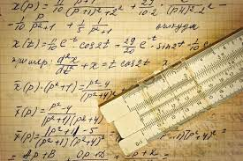
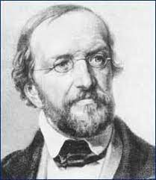
Peter Gustav Lejeune Dirichlet
mathematician who made valuable contributions to number theory, analysis, and mechanics.
Dirichlet made notable contributions still associated with his name in many fields of mathematics . In number theory he proved the existence of an infinite number of primes in any arithmetic series a + b, 2a + b, 3a + b, . . ., na + b, in which a and b are not divisible by one another.

Slide 2
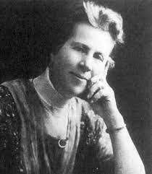
Grace Chisholm Young
She was an English mathematician who together with her husband William Young wrote many mathematical articles and several books.
She won the 1915 Gamble Prize at Cambridge (given by Girton College to distinguished alumnae) for an essay on the foundations of calculus. The most famous result with which Grace Young is identified is the Denjoy-Young-Saks theorem

