Slide 1
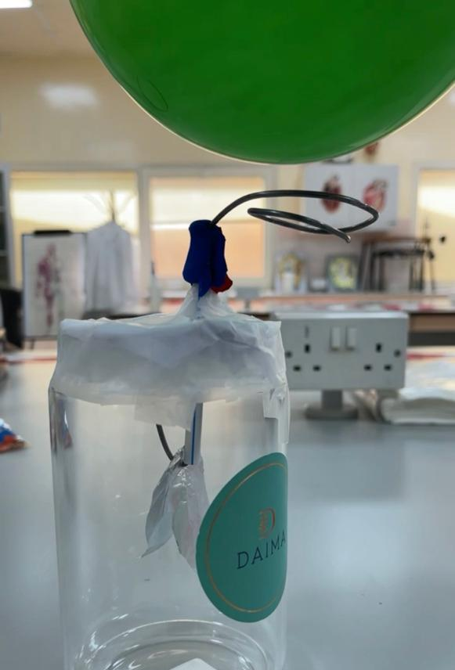
Hand-made Electroscope
Done By: Mohamed Adnan Al Ali
Class 12CB

Slide 2
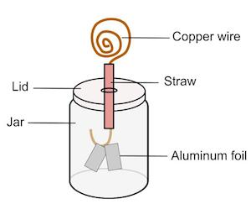
Aim
To bulid an electroscope to detect the present of electric charge.

Slide 3
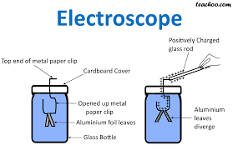
Tools
Glass Jar
Paper
Metal wire
Tape
Playdo
Alaminum foil
Straw

Slide 4
Theory
When you rub a balloon and later you put it above the spiral metal the electrons will go in and that’s why the aluminum foil repel .

Slide 5
Procedure
I collected all the materials.
I attched them all togather .
The Electroscope worked and it can detect the present of electric charge.

